Slide 1

Welcome To our
Presentation
On
HUMAN RESOURCE MANAGEMENT SYSTEM

Slide 2
Introduction
-> HRMS stands for Human Resources Management System, and it's a software suite that helps organizations manage their internal HR functions. HRMS is also known as human resources information system (HRIS) or human capital management (HCM) software.
-> It is used Company , Bank , Office , Insourance etc.

Slide 3
Which Problem A Company Can face Without Online HRMS Based Software!
Project management
Change management
Configuration and testing
HRMS data accuracy
Testing the data
Data security
Adequate user training
Compliance
Scalability

Slide 4
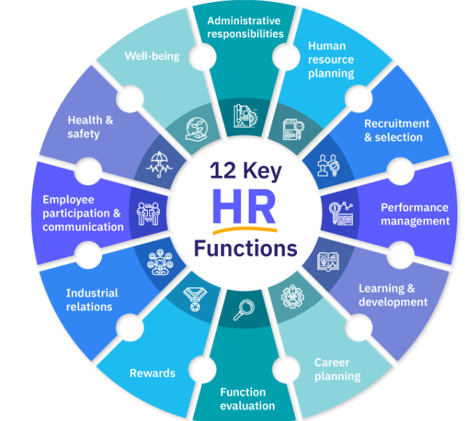
Key Function of Our Project

Slide 5
Time and Attendance
Time and attendance (T&A) in human resources (HR) management is the process of tracking employee work hours and attendance. It includes:
Creating schedules: Designing and publishing schedules for employees.
Recording hours: Tracking when employees start and end their shifts, and how long they take breaks.
Calculating payroll: Calculating employee hours, wages, and withholdings for payroll.
Managing attendance: Ensuring accurate attendance recording and managing schedules.

Slide 6
Key Features
HTML
CSS
JAVA SCRIPT
DATABASE- MONGO DB

Slide 7
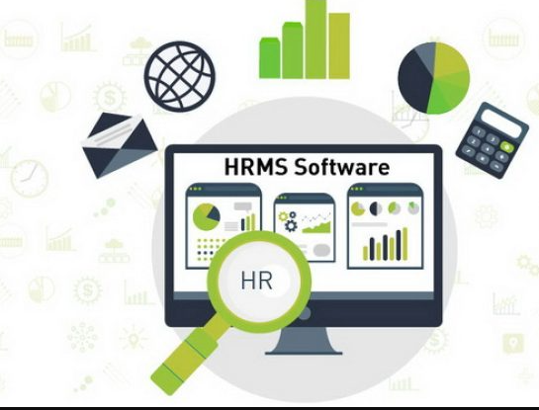
HRMS Software
HR database
Recruitment
Performance management
Benefits administration
Workforce management
Time and attendance
Absence and leave management
Learning and development
Talent management
HR analytics

Slide 8

1. Centralized Database ->
At the heart of any HRMS is its centralized database, which serves as a secure, single source of truth for all employee-related data where you can store, organize, and access employee records, payroll details, and compliance documentation. This increases efficiency and ensures data accuracy across different HR functions, facilitating decision-making and improving productivity for your HR team.
2. Benefits Administration ->
Managing employee benefits and factoring them into payroll calculations can be a time drain. A human resource management system allows easy access to benefits administration modules that connect you to benefits like pension plans, medical insurance, maternity leave, sick leave, and vacation.

Slide 9

4. Self Service (Management) ->
Managers’ self-service functions help you speed up HR processes and allow you to carry out various tasks like reviewing candidate applications, entering performance review data, approving expenses claims, and accessing employee information.
5. Self Service (Employee) ->
Employee self-service functions enable your employees to input personal data, check on the status of their benefits, and request time off. This can save your HR department a ton of time as they no longer have to be the go-between your staff and this information.

Slide 10
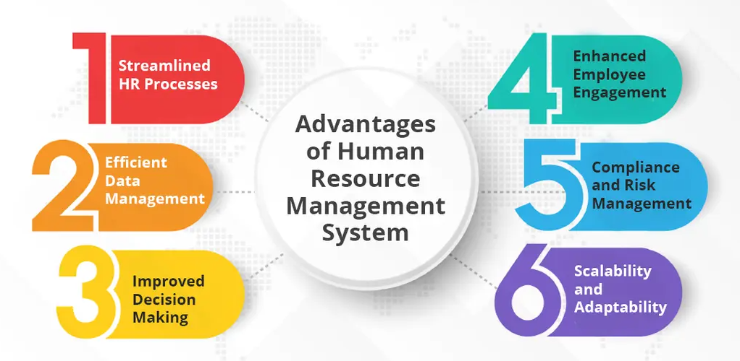
HRMS Advantage

Slide 11
Link of Code Base
https://github.com/Akash123325

Slide 12
Summary of HRMS
HRMS stands for human resource management system – often referred to as human capital management (HCM) software. Companies use an HRMS to digitalise, automate, and centralise core HR processes, such as employee data storage, benefits administration, time and attendance, and payroll.

